Slide 1
Shopping Customer Segmentation
Unsupervised Machine Learning Project(KMeans-Clustering).

Slide 2
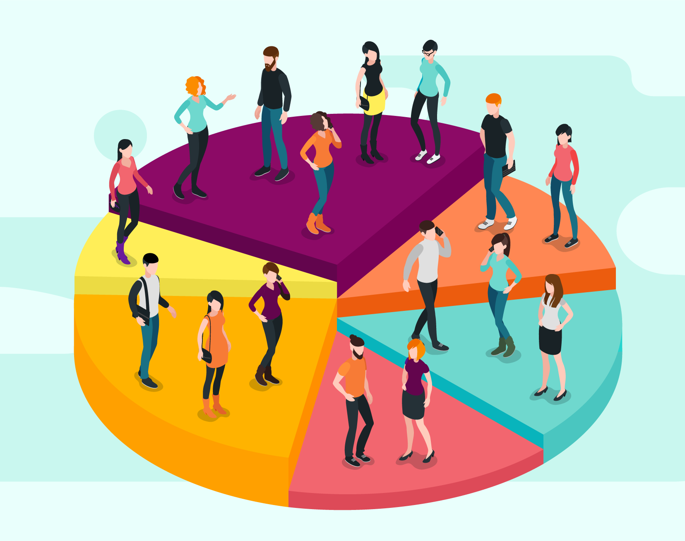
Segment Shopping Customers
Problem Statement: Understand the target customers for the marketing team
Context: Identify the most important shopping groups based on income, age, and the shopping score.
Find out the ideal number of groups with a label for each.

Slide 3
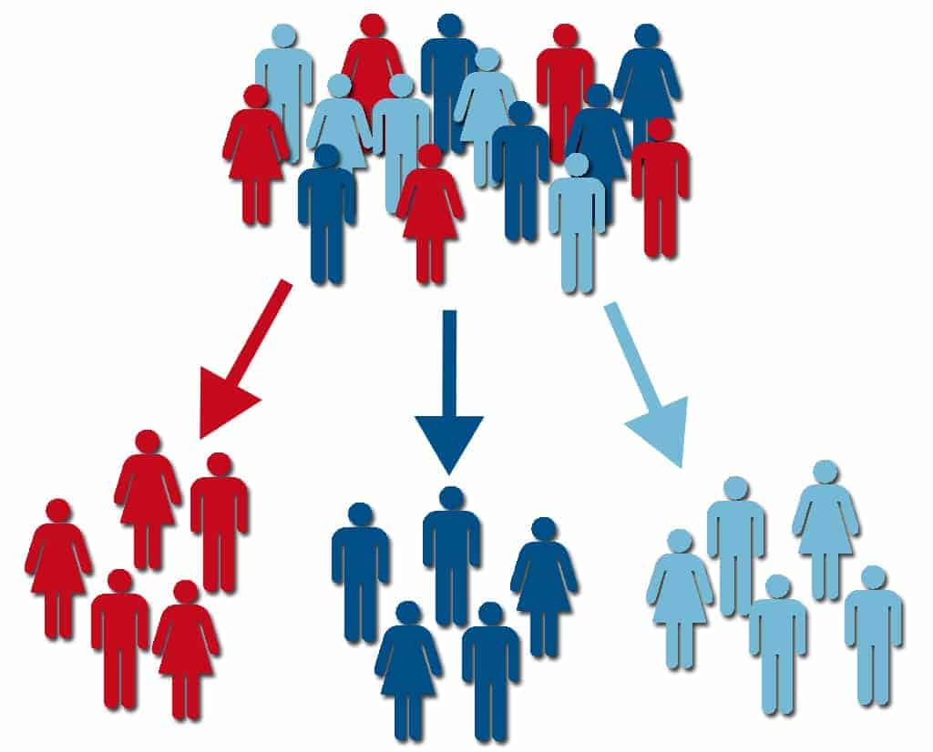
Objective Market Segmentation
Divide your mall target market into approachable groups. Create subsets of a market based on demographics behavioral criteria to better understand the target for marketing activities.

Slide 4
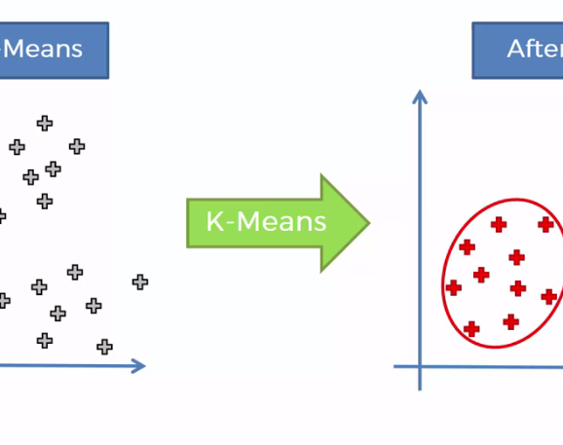
The Approach
Perform some exploratory data analysis (EDA); Univariate, Bivariate analysis.
Use KMeans-clustering Algorithm to create our customer clusters
Use summary Statistics to describe these clusters
Finally visualize and discuss our findings.

Slide 5
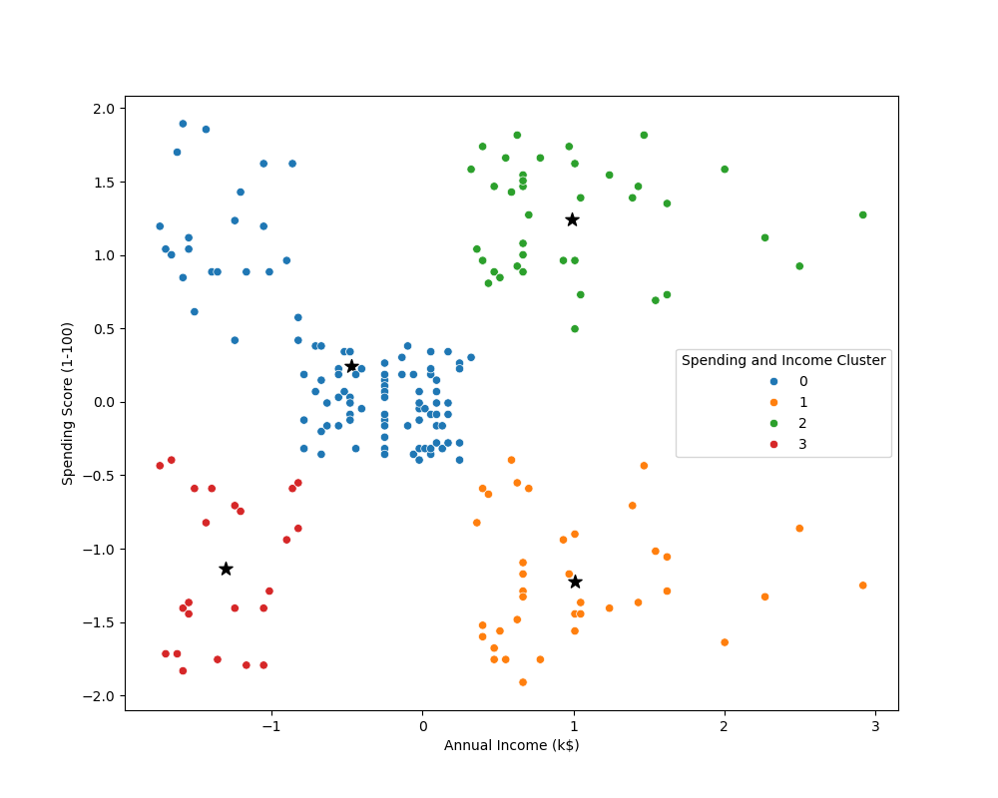
Analysis and Findings
Target group would be cluster 2 which has a high spending score and high income.
About 54 percent of cluster 2 shoppers are women. We should look for ways to attract these customers using a marketing campaign targeting popular items in this cluster.
The average of customers in cluster 2 is 32. we can assume that these are working class customers and effective consideration in tailored products for such customer class.
Cluster 0 presents an interesting opportunity to market to the customers for sales event on popular items.

